Slide 1
8. Text Processing

Slide 2
Objectives
2
Abundance of Digitized Text
The problem of String Matching
Brute-Force algorithm
Knuth-Morris-Pratt Algorithm
Data Compression
Condition for Data Compression
Huffman Coding Algorithm
LZW Algorithm
Run-length Encoding
Notes:
2

Slide 3
Abundance of Digitized Text
Despite the wealth of multimedia information, text processing remains one of the dominant functions of computers.
Computers are used to edit, store, and display documents, and to transport files over the Internet.
Furthermore, digital systems are used to archive a wide range of textual information, and new data is being generated at a rapidly increasing pace.

Slide 4
Abundance of Digitized Text
Common examples of digital collections that include textual information are:
Snapshots of the World Wide Web, as Internet document formats HTML and XML are primarily text formats, with added tags for multimedia content.
All documents stored locally on a users computer
Email archives
Compilations of status updates on social networking sites such as Facebook
Feeds from microblogging sites such as Twitter and Tumblr
These collections include written text from hundreds of international languages.
Furthermore, there are large data sets (such as DNA) that can be viewed computationally as “strings” even though they are not language.
In this lesson, we explore some of the fundamental algorithms that can be used to efficiently analyze and process large textual data sets.

Slide 5

The problem of String Matching
Given a string S, the problem of string matching deals with finding whether a pattern p occurs in S and if p does occur then returning position in S where p occurs.

Slide 6
Brute-Force algorithm
One of the most obvious approach towards the string matching problem would be to compare the first element of the pattern to be searched p, with the first element of the string S in which to locate p.
If the first element of p matches the first element of S, compare the second element of p with second element of S.
If match found proceed likewise until entire p is found.
If a mismatch is found at any position, shift p one position to the right and repeat comparison beginning from first element of p.
This algorithm is called Brute-Force. Its' complexity (worst case) is O(nm).

Slide 7
Brute-Force algorithm demo - 1
Below is an illustration of how the previously described O(mn) approach works.
String S
a | b | c | a | b | a | a | b | c | a | b | a | c
Pattern p
a | b | a | a

Slide 8
Brute-Force algorithm demo - 2
Step 1: compare p[1] with S[1]
S
a | b | c | a | b | a | a | b | c | a | b | a | c
p
a | b | a | a
Step 2: compare p[2] with S[2]
S
a | b | c | a | b | a | a | b | c | a | b | a | c
p
a | b | a | a

Slide 9
Brute-Force algorithm demo - 3
Step 3: compare p[3] with S[3]
S
a | b | c | a | b | a | a | b | c | a | b | a | c
Since a mismatch is found, shift p one position to the right
and repeat comparison beginning from first element of p
p
a | b | a | a
Mismatch occurs here..
S
a | b | c | a | b | a | a | b | c | a | b | a | c
Finally, a match would be found after shifting p three times to the right side.
p
a | b | a | a

Slide 10
Brute-Force algorithm demo - 4
Drawbacks: if m is the length of pattern p and n the length of string S, the matching time is of the order O(mn). This is a certainly a very slow running algorithm.
Explain: The reason makes this approach so slow is the fact that elements of S with which comparisons had been performed earlier are involved again and again in comparisons in some future iterations.
For example: when mismatch is detected for the first time in comparison of p[3] with S[3], pattern p would be moved one position to the right and matching procedure would resume from here. Here the first comparison that would take place would be between p[0]=a and S[1]=b. It should be noted here that S[1]=b had been previously involved in a comparison in step 2. this is a repetitive use of S[1] in another comparison.
It is these repetitive comparisons that lead to the runtime of O(mn).

Slide 11
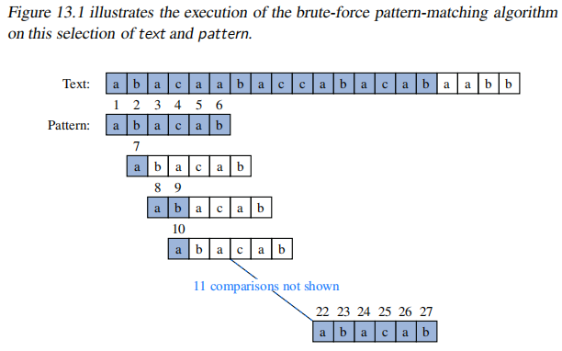
Brute-Force algorithm demo - 4

Slide 12
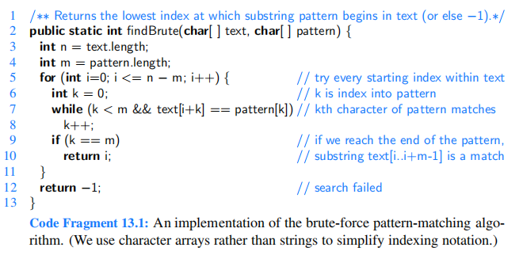
Brute-Force algorithm demo - 4

Slide 13
The Boyer-Moore Algorithm
Improve the running time of the brute-force algorithm by adding two potentially time-saving heuristics, as follows:
Looking-Glass Heuristic
Character-Jump Heuristic
The Boyer-Moore algorithm has a worst-case time complexity of O(nm), but, it can perform much better than that.
In fact, in some cases, it can achieve a sublinear time complexity of O(n/m), which means that it can skip some characters in the text without comparing them. This happens when the pattern has no repeated characters or when it has a large alphabet size.
Notes:
https://cmps-people.ok.ubc.ca/ylucet/DS/BoyerMoore.html

Slide 14
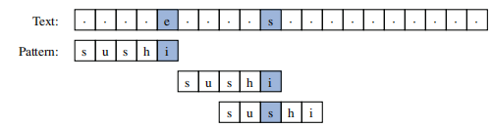
The Boyer-Moore Algorithm
Looking-Glass Heuristic: When testing a possible placement of the pattern against the text, perform the comparisons against the pattern from right-to-left.
Character-Jump Heuristic: During the testing of a possible placement of the pattern within the text, a mismatch of character text[i]=c with the corresponding character pattern[k] is handled as follows.
If c is not contained anywhere in the pattern, then shift the pattern completely past text[i] = c.
Otherwise, shift the pattern until an occurrence of character c gets aligned with text[i].

Slide 15
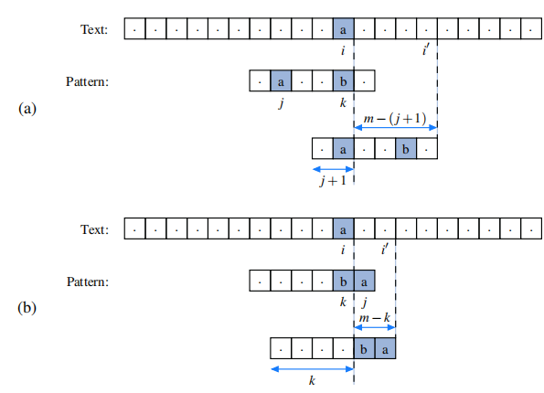
The Boyer-Moore Algorithm

Slide 16
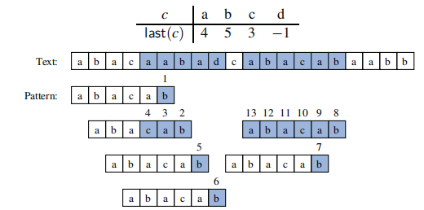
The Boyer-Moore Algorithm
Notes:
abacaabadcabacabaabb
abacab

Slide 17
The Knuth-Morris-Pratt (KMP) Algorithm - 1
Knuth, Morris and Pratt proposed a linear time algorithm for the string matching problem.
A matching time of O(n+m) is achieved by avoiding comparisons with elements of S that have previously been involved in comparison with some element of the pattern p to be matched. i.e., backtracking on the string S never occurs
Notes:
https://cmps-people.ok.ubc.ca/ylucet/DS/KnuthMorrisPratt.html

Slide 18
The Knuth-Morris-Pratt Algorithm - 2
To illustrate the ideas of the algorithm, we consider the following example:
Index i | 0 | 1 | 2 | 3 | 4 | 5 | 6 | 7 | 8 | 9 | 10 | 11 | 12
Text a | 1 | 0 | 1 | 0 | 0 | 0 | 1 | 0 | 1 | 0 | 1 | 1 | 0
Pattern p | 1 | 0 | 1 | 0 | 1 | 1
 |  | 1 | 0 | 1 | 0 | 1 | 1
 |  |  | 1 | 0 | 1 | 0 | 1 | 1
Thus the size of the text a n = 13 and the pattern's one is m = 6.
At a high level, the KMP algorithm is similar to the naive algorithm: it considers shifts in order from 0 to n-m, and determines if the pattern matches at that shift. The difference is that the KMP algorithm uses information gleaned from partial matches of the pattern and text to skip over shifts that are guaranteed not to result in a match.

Slide 19
The Knuth-Morris-Pratt Algorithm - 3
Index i | 0 | 1 | 2 | 3 | 4 | 5 | 6 | 7 | 8 | 9 | 10 | 11 | 12
Text a | 1 | 0 | 1 | 0 | 0 | 0 | 1 | 0 | 1 | 0 | 1 | 1 | 0
Pattern p | 1 | 0 | 1 | 0 | 1 | 1
 |  | 1 | 0 | 1 | 0 | 1 | 1
 |  |  | 1 | 0 | 1 | 0 | 1 | 1
We call the starting position for a matching is r. Thus, for the first matching r = 0. We starting to compare a[i] with p[j], j = 0, 1, 2, ..., m-1; i = r+j. The result is:
a[0] = p[0], a[1] = p[1], a[2] = p[2], a[3] = p[3], a[4] ≠ p[4] (1)
Thus r = 0 is a wrong "starting position". The first wrong position is j = k = 4. By Brute-Force (BF) algorithm, we set r' = r+1 = 1 and starting new matching by comparing:
(a[1],p[0]), (a[2],p[1]), (a[3],p[2]), (a[4], p[3]),...
However from (1) we can replace the above comparing with the following:
(p[1],p[0]), (p[2],p[1]), (p[3],p[2]), (a[4],p[3]),...
In the general case:
(p[1],p[0]), (p[2],p[1]), ..., (p[k-1],p[k-2]), (a[k],p[k-1]),...
The bold comparisions based on the pattern only and can be pre-done. These can be done by sliding a copy pp of the pattern to right 1 position. We can see that in the given example this comparision is wrong.

Slide 20
The Knuth-Morris-Pratt Algorithm - 4
Index i | 0 | 1 | 2 | 3 | 4 | 5 | 6 | 7 | 8 | 9 | 10 | 11 | 12
Text a | 1 | 0 | 1 | 0 | 0 | 0 | 1 | 0 | 1 | 0 | 1 | 1 | 0
Pattern p | 1 | 0 | 1 | 0 | 1 | 1
Slide 1 |  | 1 | 0 | 1 | 0 | 1 | 1
Slide 2 (ok) |  |  | 1 | 0 | 1 | 0 | 1 | 1
Now we slide the pattern pp to right 2 positions and we can see the bold comparisions are matched. We can start to compare a[4] with p[2] only.
(p[2],p[0]), (p[3],p[1]), (a[4],p[2]),...
For a given pattern p, we can precalculate the so called Knuth/Morris/Pratt failure function next(j) and stores them in an array T[j], where j = 0, 1, ..., m-1.
We define next(0) = -1, next(1) = 0. For j, 2 ≤ j ≤ m-1 the next(j) takes a value in an interval [0, j-1].
This value can be calculated by sliding a copied pp to right by some positions and comparing the values of pp with the p's values.

Slide 21
The Knuth-Morris-Pratt Algorithm - 5
In summary, a "step" of the KMP algorithm makes progress in one of two ways. Before the step, suppose that p[0,..,k-1] is already matched with a[r,..., r+k-1].
If p[k] = a[r+k], the length of the match is extended, unless k = m-1, in which case we have found a complete match of the pattern in the text.
If p[k] ≠ a[r + k], the pattern slides to the right to the index h = next[k]. (Thus we start to compare p[h] with a[r+k]).
In either case, progress is made. The algorithm repeats such steps of progress until the end of the text is reached.
Running Time
Each time through the loop, either we increase i or we slide the pattern right. Both of these events can occur at most n times, and so the repeat loop is executed at most 2n times. The cost of each iteration of the repeat loop is O(1). Therefore, the running time is O(n), assuming that the values (q) are already computed.

Slide 22
The KMP Algorithm examples
Example 1:
i | 0 | 1 | 2 | 3 | 4 | 5 | 6
p[i] | A | B | C | D | A | B | D
T[i] | -1 | 0 | 0 | 0 | 0 | 1 | 2
Example 2:
i | 0 | 1 | 2 | 3 | 4 | 5 | 6 | 7 | 8
p[i] | A | B | A | C | A | B | A | B | C
T[i] | -1 | 0 | 0 | 1 | 0 | 1 | 2 | 3 | 2
Example 3:
i | 00 | 01 | 02 | 03 | 04 | 05 | 06 | 07 | 08 | 09 | 10 | 11 | 12 | 13 | 14 | 15 | 16 | 17
p[i] | P | A | R | T | I | C | I | P | A | T | E |  | I | N |  | P | A | R
T[i] | -1 | 0 | 0 | 0 | 0 | 0 | 0 | 0 | 1 | 2 | 0 | 0 | 0 | 0 | 0 | 0 | 1 | 2

Slide 23
Data Compression - 1
“In computer science and information theory, data compression or source coding is the process of encoding information using fewer bits (or other information-bearing units) than an unencoded representation would use through use of specific encoding schemes.” (Wikipedia)
Compression reduces the consumption of storage (disks) or bandwidth.
However, it needs processing time to restore or view the compressed code.
Raw data
encoding
Compressed data
decoding

Slide 24
Data Compression - 2
24
Types of compression
Lossy: MP3, JPG
Lossless: ZIP, GZ
Compression Algorithm:
Huffman Encoding
Lempel-Ziv
RLE: Run Length Encoding
Performance of compression depends on file types.

Slide 25
Compress data by decoding symbols contained in it (lossless compression)
The information content of the set M, called the entropy of the source X = (x₁, x₂,…, x_{n} ), is defined by:
L_{ave} = H = P(x₁)L(x₁) + · · · + P(x_{n})L(x_{n})
Where L(x_{i}) = - log₂P(x_{i}), which is the minimum length of a codeword for symbol x_{i} (Claude E.Shannon, 1948). Shannons entropy represents an absolute limit on the best possible lossless compression of any communication.
To compare the efficiency of different data compression methods when applied to the same data, the same measure is used; this measure is the compression rate
length(input) – length (output)
length(input)
Codeword:
sequence of bits of a code corresponding to a symbol.

Slide 26
Uniquely Decodable Codes
A variable length code assigns a bit string (codeword) of variable length to every message value
e.g. a = 1, b = 01, c = 101, d = 011
What if you get the sequence of bits 1011 ?
Is it aba, ca, or, ad?
A uniquely decodable code is a variable length code in which bit strings can always be uniquely decomposed into its codewords.

Slide 27
Prefix Codes
A prefix code is a variable length code in which no codeword is a prefix of another codeword
e.g a = 0, b = 110, c = 111, d = 10
Can be viewed as a binary tree with message values at the leaves and 0 or 1s on the edges.
0
1
0
1
a
0
1
d
b
c

Slide 28
Average Length
For a code C with associated probabilities p(c) the average length is defined as
We say that a prefix code C is optimal if for all prefix codes C, l_{a}(C) ≤ l_{a}(C)
The Huffman code is known to be provably optimal under certain well-defined conditions for data compression.

Slide 29
Huffman Coding algorithm
29
Main idea: Encode high probability symbols with fewer bits
Make a leaf node for each code symbol
Add the generation probability or the frequency of each symbol to the leaf node (arrange them from left to right in descending order by probability)
Take the two leaf nodes with the smallest probability and connect them into a new node
Add 1 or 0 to each of the two branches
The probability of the new node is the sum of the probabilities of the two connecting nodes
If there is only one node left, the code construction is completed. If not, go back to (2)
Notes:
https://planetcalc.com/2481/

Slide 30
Huffman Coding example - 1
Character (or symbol) frequencies
A : 20% (.20) e.g., A occurs 20 times in a 100 character document, 1000 times in a 5000 character document, etc.
B : 9% (.09)
C : 15% (.15)
D : 11% (.11)
E : 40% (.40)
F : 5% (.05)
Also works if you use character counts
Must know frequency of every character in the document
Notes:
30

Slide 31
Huffman Coding example - 2
Symbols and their associated frequencies.
Now we combine the two least common symbols (those with the smallest frequencies) to make a new symbol string and corresponding frequency.
E
.40
A
.20
C
.15
D
.11
B
.09
F
.05
Notes:
31

Slide 32
Huffman Coding example - 3
Heres the result of combining symbols once.
Now repeat until youve combined all the symbols into a single string.
E
.40
A
.20
C
.15
BF
.14
D
.11
B
.09
F
.05
Notes:
32

Slide 33
Huffman Coding example - 4
Heres the result of combining symbols once.
Now repeat until youve combined all the symbols into a single string.
E
.40
BFD
.25
A
.20
C
.15
BF
.14
D
.11
B
.09
F
.05

Slide 34
Huffman Coding example - 5
Heres the result of combining symbols once.
Now repeat until youve combined all the symbols into a single string.
E
.40
AC
.35
BFD
.25
A
.20
C
.15
BF
.14
D
.11
B
.09
F
.05
Notes:
34

Slide 35
Huffman Coding example - 6
BFDAC
.60
E
.40
AC
.35
BFD
.25
A
.20
C
.15
BF
.14
D
.11
B
.09
F
.05
Notes:
35

Slide 36
Huffman Coding example - 7
Codes: (reading from top to bottom)
A: 000
B: 0100
C: 001
D: 011
E: 1
F: 0101
Note
None are prefixes of another
BFDACE
1.00
0
1
BFDAC
.60
E
.40
0
1
AC
.35
BFD
.25
0
1
0
1
A
.20
C
.15
BF
.14
D
.11
0
1
B
.09
F
.05
Notes:
36

Slide 37
Huffman Coding example - 8
Character | Code | Length | Probability
A | 000 | 3 | .20
B | 0100 | 4 | .09
C | 001 | 3 | .15
D | 011 | 3 | .11
E | 1 | 1 | .40
F | 0101 | 4 | .05
Average Code Length:
(3 x 0.20) + (4 x 0.09) + (3 x 0.15) + (3 x 0.11) + (1 x 0.40) + (4 x 0.05)
= 1.89 digits
Notes:
37

Slide 38
Huffman Coding notes
There is no unique Huffman code
Assigning 0 and 1 to the branches is arbitrary
If there are more nodes with the same probability, it doesnt matter how they are connected.
However, if the probability in each node is unique and the left nodes probability is always larger than the rights one, then the code is unique.
Every Huffman code has the same average code length!
Notes:
38

Slide 39
Some important statements in Huffman Encoding program
static final int R = 256;
// tabulate frequency counts
int[] freq = new int[R]; = new int[R];
for (int i = 0; i < input.length; i++) freq[input[i]]++;
// build Huffman tree
Node root = buildTree(freq);
// build code table
String [] st = new String[R]; buildCode(st, root, "");
// make a codewords table from symbols and their encodings
void buildCode(String[] st, Node x, String s)
{ if (!x.isLeaf())
{buildCode(st, x.left, s + 0); buildCode(st, x.right, s + 1); }
else
{st[x.ch] = s; }
}
Notes:
39

Slide 40
Lempel-Ziv Compression
40
Encode sequences of symbols with location of sequence in a dictionary => dictionary coder
Originated by Abraham Lempel and Jacob Ziv, improved by Tery Welch in 1984 (that is why it gets name LZW)
This coding method is lossless coding
Algorithms versions: LZ77, LZ78 and LZW

Slide 41
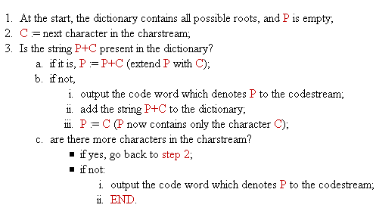
LZW Encoding Algorithm
41
P is a current word, thus at the start, it is empty.
Notes:
GIF file
41

Slide 42
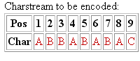
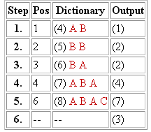
LZW Algorithm - Encoding process demo
Contents of the dictionary at the beginning of encoding: (1)A (2)B (3)C
The column Step indicates the number of the encoding step. Each encoding step is completed when the step 3.b. in the encoding algorithm is executed.
The column Pos indicates the current position in the input data.
The column Dictionary shows the string that has been added to the dictionary and its index number in brackets.
The column Output shows the code word output in the corresponding encoding step.
The compressed output: (1)(2)(2)(4)(7)(3)
Notes:
GIF file
42

Slide 43
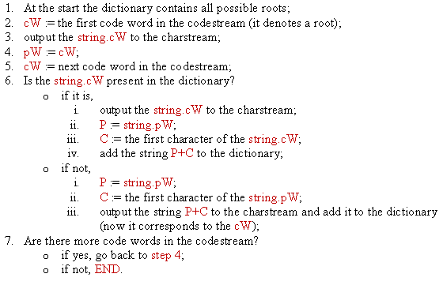
LZW Decoding Algorithm
43
Notes:
43

Slide 44
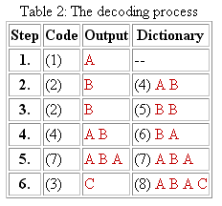
LZW Algorithm - Decoding process demo
Contents of the dictionary at the beginning of decoding: (1)A (2)B (3)C
Lets analyze the step 4. The previous code word (2) is stored in pW, and cW is (4). The string.cW is output ("A B"). The string.pW ("B") is extended with the first character of the string.cW ("A") and the result ("B A") is added to the dictionary with the index (6). We come to the step 5. The content of cW=(4) is copied to pW, and the new value for cW is read: (7). This entry in the dictionary is empty. Thus, the string.pW ("A B") is extended with its own first character ("A") and the result ("A B A") is stored in the dictionary with the index (7). Since cW is (7) as well, this string is also sent to the output.
The compressed output: (1)(2)(2)(4)(7)(3)
The decompressed output: ABBABABA
Notes:
GIF file
44

Slide 45
Run-Length Encoding
FFFFOOOOFFFOOFFFFFOOOOOOOO
Raw :
4
4
3
2
5
7
Compressed:
4F4O3F2O5F7O
Compression Rate = (25-12)/25 = 52%

Slide 46
Exercise
In Huffman coding, both the sender and receiver must have a copy of the same code in order for the decoded file to match the encoded file.
A. True
B. False
Notes:
A

Slide 47
Exercise
Run length encoding is a lossless compression method in which repeated occurrences of a symbol are replaced by one occurrence of the symbol followed by the number of occurrences.
A. True
B. False

Slide 48
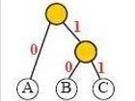
Exercise
Using the Huffman code tree below. What is the result of decoding the string: 0010101010010?
A. BABABBBA
B. AABBABAB
C. CAABBBBA
D. AABBBBAB

Slide 49
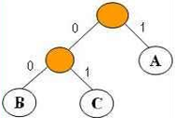
Exercise
Using the Huffman code tree below. What is the result of decoding the string: 1100001000100 ?
A. AABBABCB
B. CAABBBAC
C. AABBBCBC
D. AABBBCAB

Slide 50
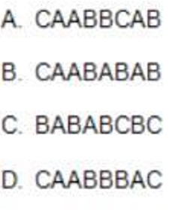
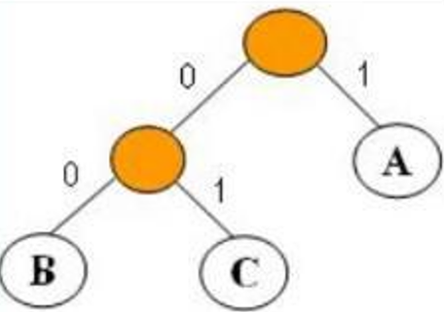
Exercise
Using the Huffman code tree below. What is the result of decoding the string: 0111000000101 ?

Slide 51
Exercise
Given a raw message 'FFFFOOOOFFFOOFFFFFOO' (without single quote). Run the run-length algorithm for that message, what is the output?
A. 4F4O3F2O5F
B. FFFFOOOOFFFOOFFFFFOO
C. 4F4O3F2O5F2O
D. 4F4O3F2O5F2OO

Slide 52
Exercise
Given a raw message 'BBBBQQQQBBBQQBBBBBQQ' (without single quote).
Run the run-length algorithm for that message, what is the output?

Slide 53
Exercise
Suppose you are using the LZW algorithm to encode the message AABAACAABD contents
at the beginning of encoding are:
(1) A (2) B (3) C (4) D
What string is denoted by code word (7)?
A. AB
B. AC
C. BA
D. ABA
E. BAA

Slide 54
Exercise
Suppose you are using the LZW algorithm to encode the message AABCADAB contents of the dictionary at
the beginning of encoding are:
(1) A (2) B (3) C (4) D
What string is denoted by code word (5)?
A. AA
B. AB
C. AAB
D. ABC

Slide 55
Exercise
Suppose you are using the LZW algorithm to encode the message CCCDABCAADA conten
dictionary at the beginning of encoding are:
(1) A (2) B (3) C (4) D
What are the first 4 code words when encoding the above string?

Slide 56
Summary
Abundance of Digitized Text
The problem of String Matching
Brute-Force algorithm
Knuth-Morris-Pratt Algorithm
Data Compression
Condition for Data Compression
Huffman Coding Algorithm
LZW Algorithm
Run-length Encoding

Slide 57
Reading at home
Text book: Data Structures and Algorithms in Java
13 Text Processing 573
13.1 Abundance of Digitized Text - 574
13.2 Pattern-Matching Algorithms - 576
13.2.1 Brute Force - 576
13.2.3 The Knuth-Morris-Pratt Algorithm - 582
13.4 Text Compression and the Greedy Method - 595
13.4.1 The Huffman Coding Algorithm - 596

